Slide 1


User
漏洞示例：CWE-89 SQL 注入
LLama
eee
No
Input
Code to fix SQL injection vulnerability
cursor.execute("SELECT * FROM users WHERE id = " + user_id)
Text Only
=
➕
Code to fix SQL injection vulnerability
Prefix Control
Sven
=
cursor.execute("SELECT * FROM users WHERE id = '%s'" % user_id)
➕
Code to fix SQL injection vulnerability
RAG+
Prefix Control
cursor.execute("SELECT * FROM users WHERE id = ?", (user_id,))
Rag-Sven
➕
=
Text-Only:直接将用户输入拼接到SQL查询中，易受SQL注入攻击
Sven: 使用字符串格式化，但易受注入攻击 Rag-Sven:安全的代码：使用参数化查询，防止SQL注入

Slide 2
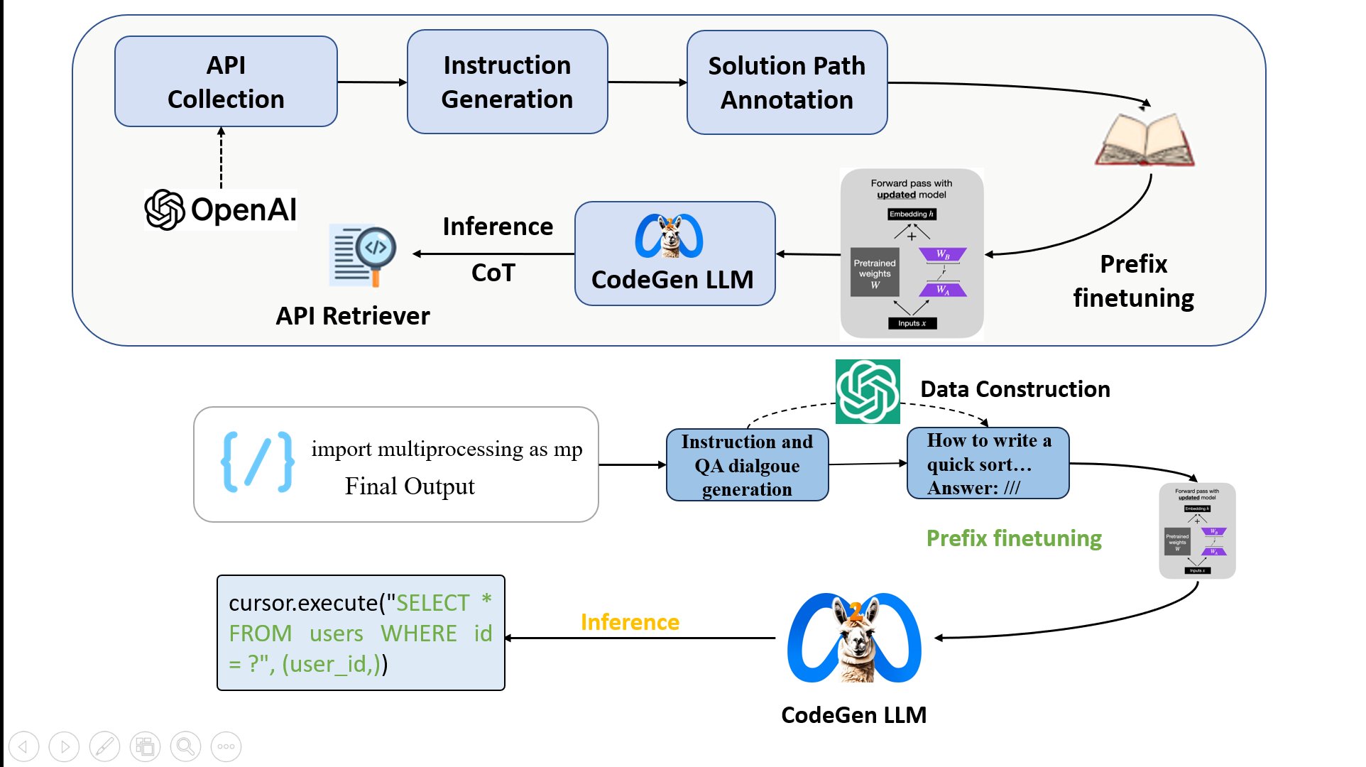

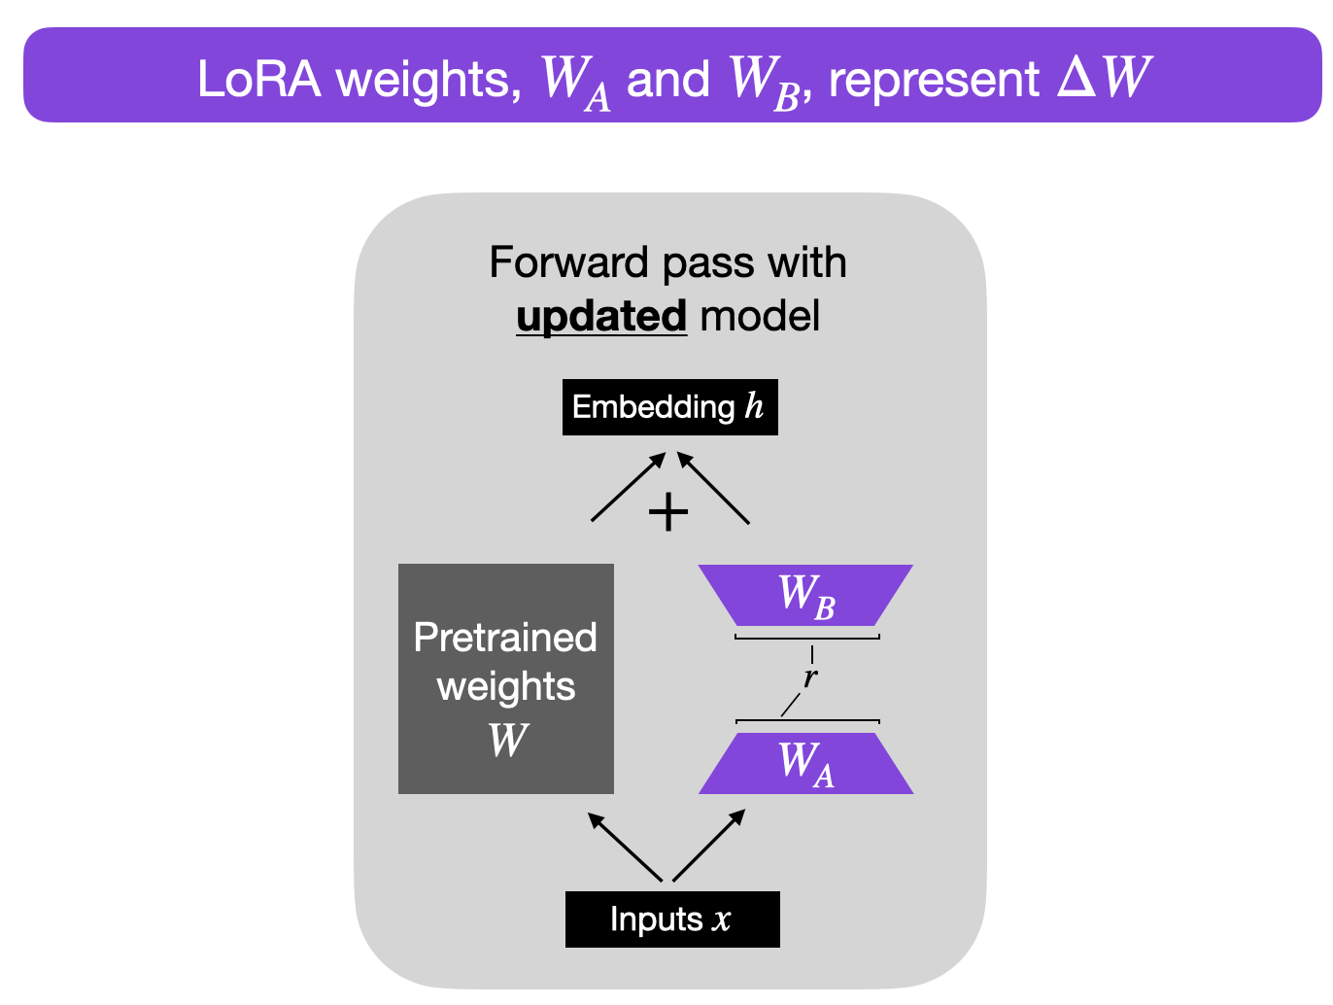





API
Collection
Instruction Generation
Solution Path Annotation
Inference
CoT
CodeGen LLM
Prefix finetuning
API Retriever
Data Construction
import multiprocessing as mp
Instruction and QA dialgoue generation
How to write a quick sort…
Answer: ///
Final Output
Prefix finetuning
cursor.execute("SELECT * FROM users WHERE id = ?", (user_id,))
Inference
CodeGen LLM

